Slide 1
Youth Smoking and Drug Analysis
Name –Priyanka Gupta
Student code – cds_07_060
Date – 16-11-2024

Slide 2
Key Objective – Create a model to predict Smoking Prevalence and Drug Experimentation among Youths
Agenda
Introduction
Data Preprocessing
Exploratory Data Analysis (EDA)
Model Building
Model Evaluation
Stream lit Deployment
Insights and Recommendation

Slide 3
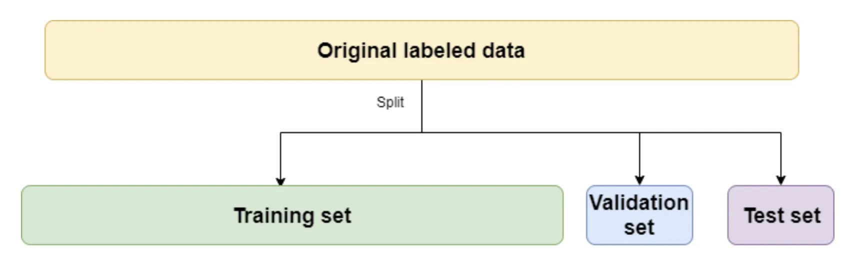
Introduction Understanding Smoking and Drug Experimentation Among Youth data
Socioeconomic_Status
We have a dataset with the columns that have information about Year, Age Group , Gender, Socioeconomic Status , Peer Influence, School Programs , Family Background , Mental Health , Access to counseling , Parental Supervision , Substance Education , Community Support , Media Influence by analysing this dataset we need to create a machine learning model that can predict Smoking prevalence and Drug Experimentation Risk among youth.

Slide 4
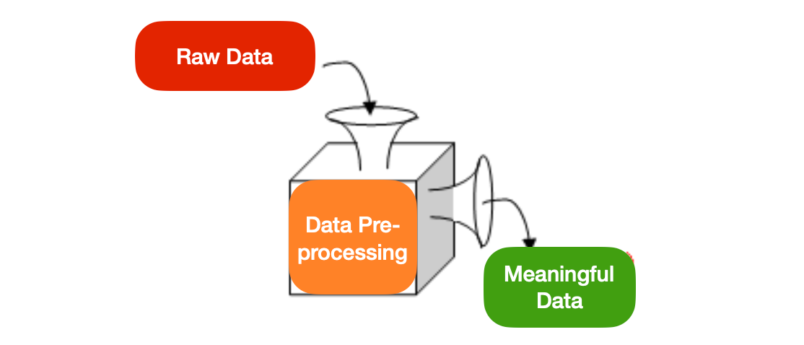
Data Preprocessing Preparing Data for Analysis and Modeling
Handling Missing Values: Need to check if there are any missing values present in any columns. As I have checked there are no missing values present.
Outlier detection: By using IQR method checked if there are any outliers present , There are no outliers detected.
Encoding Categorical Variables: Convert fields like Gender, Socioeconomic status, School Programs, Access to counseling, , Substance Education into numeric representations for analysis.
Scaling Numeric Features : Normalize continuous features like Year , Peer Influence, Family Background , Mental Health , Parental Supervision, Community Support and Media Influence to Improve algorithm performance.

Slide 5
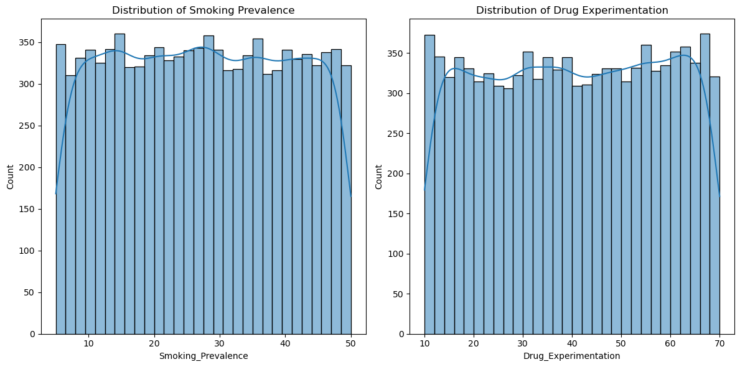
Exploratory Data Analysis (EDA) Insights from Initial Data Exploration
Distribution Analysis
Visualize the distribution of Smoking Prevalence and Drug Experimentation.

Slide 6
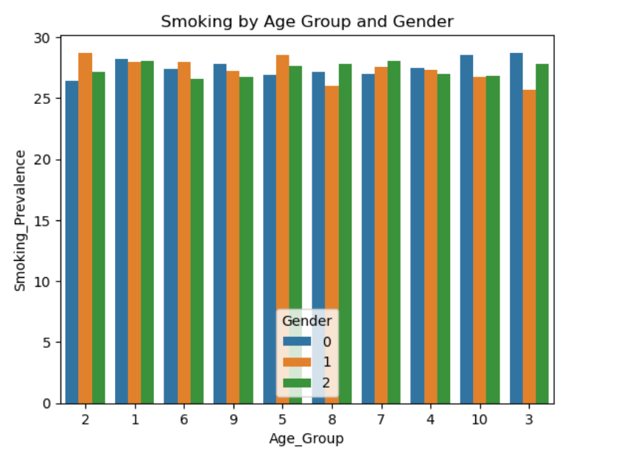
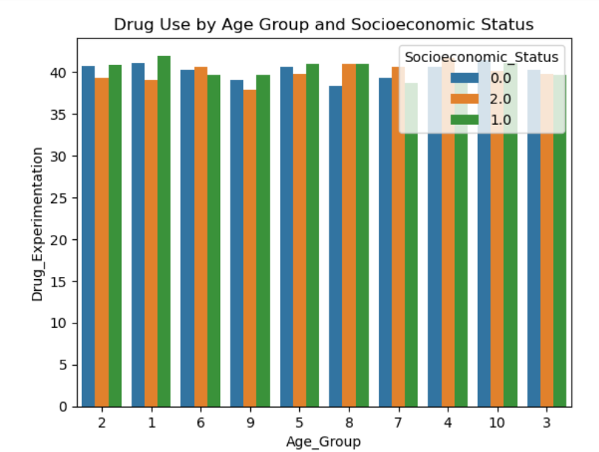
Segment Analysis
Analyze differences in smoking and drug use based on Age Group, Gender, and Socioeconomic Status.

Slide 7
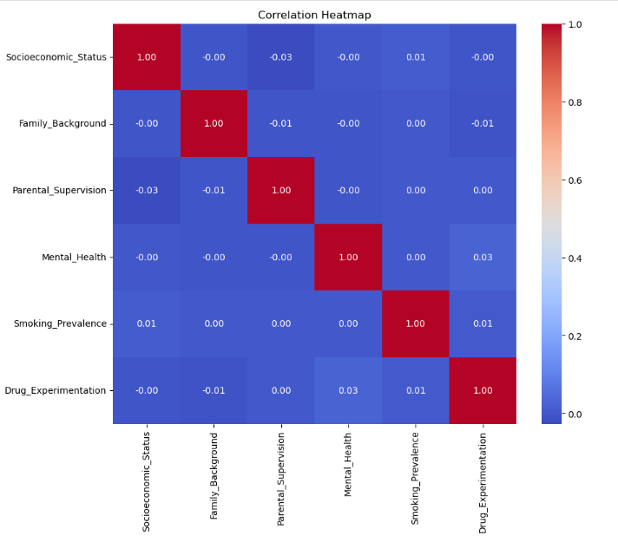
Correlation Matrix
Examine correlations between variables like Socioeconomic Status, Family Background, Parental Supervision, and Mental Health with smoking and drug use.
Using VIF Checked for multicollinearity, There is no multicollinearity between the columns.

Slide 8
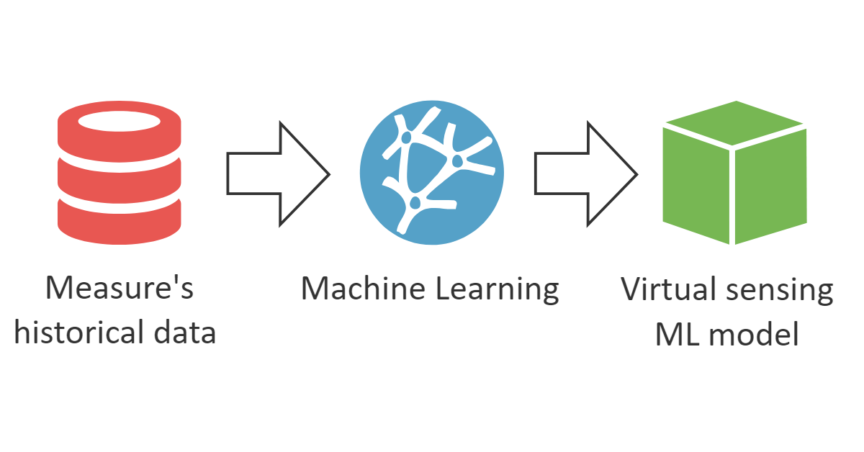
Model Building
Regression Model for Smoking Prevalence – Use model like Linear Regression and Random Forest Regressor to predict Smoking Prevalence based on other variables.
Classification Model for Drug Experimentation – Use Logistic Regressor , Decision Tree , or Gradient Boosting to categorize individuals into risk groups and predict Drug Experimentation Risk based on other variables

Slide 9
Model Evaluation
Regression Metrics – Evaluate using Mean Absolute Error (MAE) and R-squared for Smoking _Prevalence models.
Classification Metrics – Assess Drug Experimentation models with accuracy, precision, recall and F1 Score.
Cross-validation – Ensure consistent performance across data splits with K-fold Cross-Validation.
Basis of these metrics select Linear Regression model for Smoking Prevalence and Logistic Regression for Drug Experimentation.
Regression Model Evaluation:
Linear Regression –
MAE: 11.141556770586487, RMSE: 12.93357363617776,
R²: -0.0021900462329367265, MSE: 167.27732700243243
Random Forest Regressor - MAE: 11.288163950000001, RMSE: 13.197965442133308, R²: -0.043582958743823896, MSE: 174.18629181174504
Selected Regression Model: Linear Regression()
Classification Model Evaluation:
Logistic Regression – Accuracy: 0.747
Gradient Boosting – Accuracy: 0.7465
Decision Tree – Accuracy: 0.612
Selected Classification Model: Logistic Regression(max iter=1000)

Slide 10

Steps For Stream lit Deployment
Created two sav files Smoking_model.sav and Drug_model.sav
Created a py file with webapp.py
Created a file requirements.txt
Data file saved in csv format
Took all files to vs code Using Git push all files to GitHub repository
Login stream lit with GitHub and deploy the app to Stream lit
GitHub Link - https://github.com/Gpriyanka31/YOUTH_SMOKE_DRUG_DASHBOARD

Slide 11
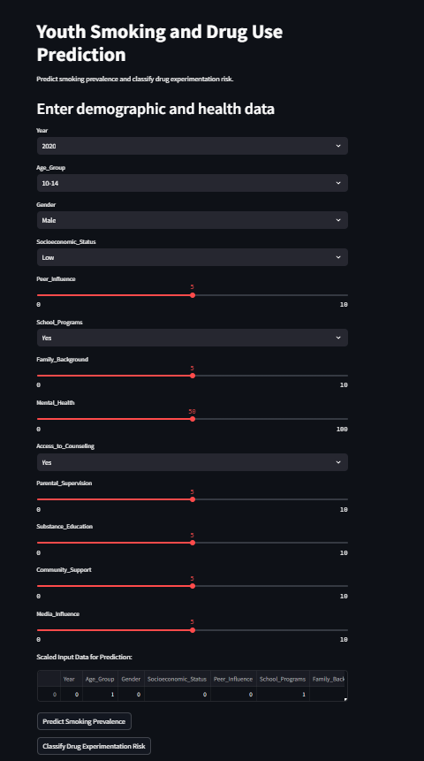
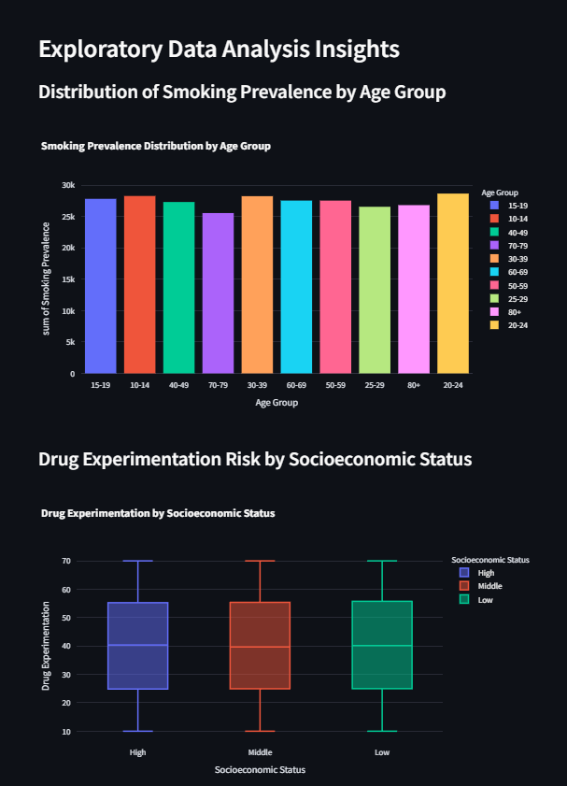
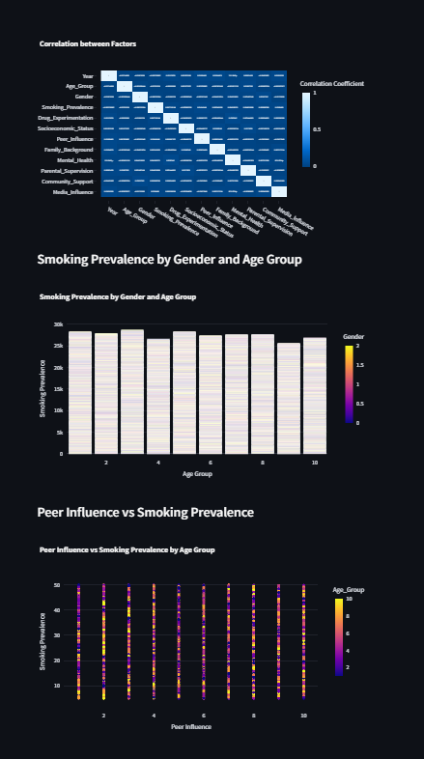
Stream lit App Interface
URL for my app - https://youthsmokedrugdashboard.streamlit.app/

Slide 12
Insights - Key Factors Associated with Increased Smoking and Drug Experimentation Among Youths
Age Group Influence: Higher smoking and drug experimentation rates tend to be observed in older youth groups (15-24).
Socioeconomic Status: Youths from low socioeconomic backgrounds often exhibit higher smoking prevalence and drug experimentation.
Mental Health: Lower mental health scores correlate strongly with increased smoking and drug experimentation.
Parental Supervision and Family Background: Lower levels of parental supervision and support are linked with increased smoking and experimentation.
Media Influence: Exposure to pro-smoking or drug-related content in media is positively associated with youth experimentation with these substances.

Slide 13
Recommendations - Based on these insights, the following recommendations can help reduce smoking and drug experimentation among youth:
Strengthen Family and Parental Support: Programs that promote active parental involvement and family cohesion can play a crucial role.
Enhance Mental Health Resources: Providing access to mental health services, including counseling, therapy, and mental health education, is essential.
Promote Community Support Programs: Community-based youth programs can provide safe, substance-free environments where youths can engage in positive activities.
Educate on Peer Influence and Resistance Skills: Programs focusing on peer influence resistance are beneficial.
Regulate Media Exposure and Provide Positive Messaging: Media campaigns that promote anti-smoking and drug-free lifestyles can counteract negative influences.
Targeted Socioeconomic Support Initiatives: For communities with lower socioeconomic status, providing economic support, academic tutoring, and career counseling may reduce stress and offer youth more productive paths, decreasing the likelihood of substance experimentation.¶.

Slide 14
Thank You

